Slide 1
Coursera Capstone Project
By: James Crandall
22 April 2021

Slide 2
Agenda
Introduction
Business Problem
Data
Methodology
Results
Discussion
Conclusion

Slide 3
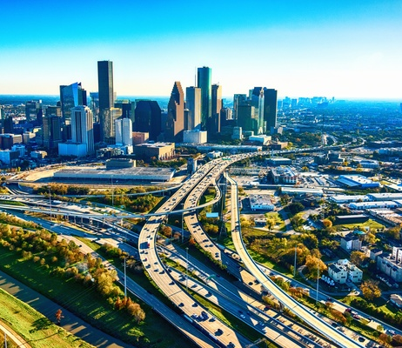
Introduction
Within the last 20 years, Houston, Texas has been an exponentially growing city for housing, population, and the energy industry. With a flood of people flocking to the city for jobs, the diversity of food and beverage selections has grown with it. Though Houston has always been known for being a multicultural city, it has greatly increased the Millennial population. Millennial’s, fueled by social media, social hangouts, social everything, are looking for institutions that allow for gatherings. With the club night life still breathing heavily, the daytime festivities are increasing with social drinking, primarily at breweries.
Microbreweries have erupted in popularity to offer as an alternative to bars and other day time hangouts. The selection of breweries come and go as fast as the fads last on social media.

Slide 4
Business Problem
What is needed is a brewery that is not surrounded by other breweries, that can tend to the local/immediate population, has good beer, and can stay busy. My client is looking for the ideal place for her brewery to call home. It will serve local clienteles and be able to ship beer to eateries and groceries. Having not only an indoor/outdoor entertainment space is critical, but there also needs to be space for brewing, packing, shipping, trucking, and of course drinking (sampling).

Slide 5
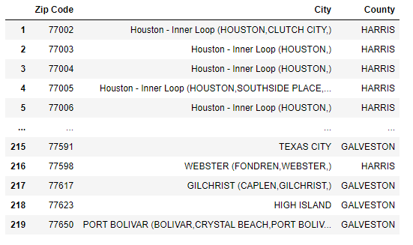
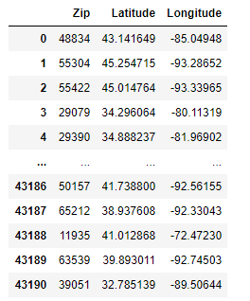
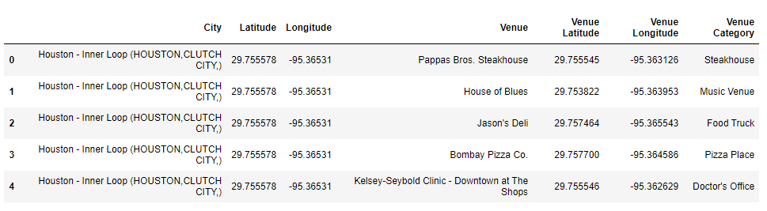
Data
Location Data Houston
Foursquare
Using HAR database (Houston Area Realtors)
This will give us City and Zip Codes
Using the US database for Zip codes
Match Zip Code to Latitude and Longitude Coordinates
Retrieve data for venues based on desired location (Houston, Texas) given a radius from geographic center
This will retrieve venue name, venue type, latitude, longitude

Slide 6
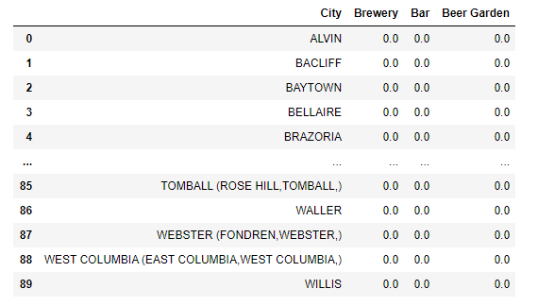
Methodology
Narrowing the field
We are looking for venues that are like that of a brewery such as Bars and Beer Gardens.
Unfortunately, we are limited to how foursquare labels venues.
There are other categories available for venue types but opening the field could start an unlike comparison of competition such as restaurants.

Slide 7
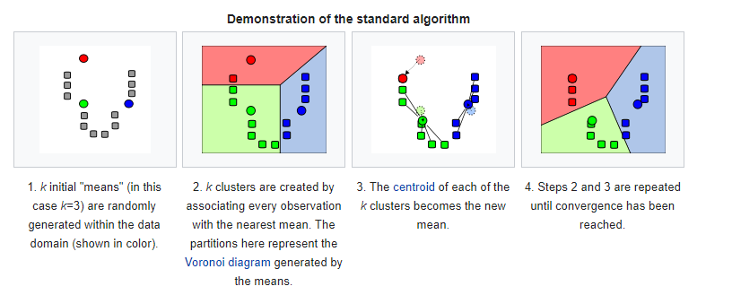
Methodology
Clustering alike
Using scikit learn k-Means through Python script
k-Means is an unsupervised learning method that partitions data based on similarities given
The goal is to minimize the distance alike and maximize the distance not alike in qualities based on Euclidean distances

Slide 8
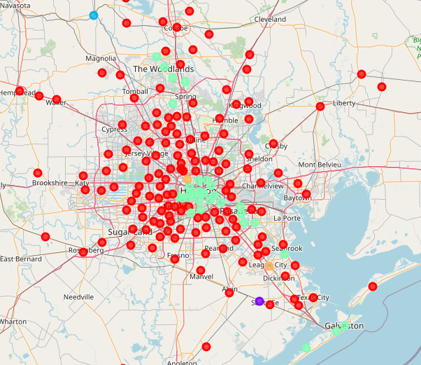
Results
Using Folium and our desired dataset we can observe the k-means clustering geographically

Slide 9
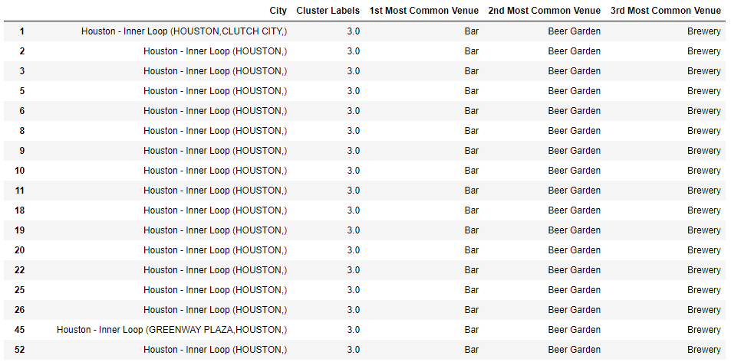
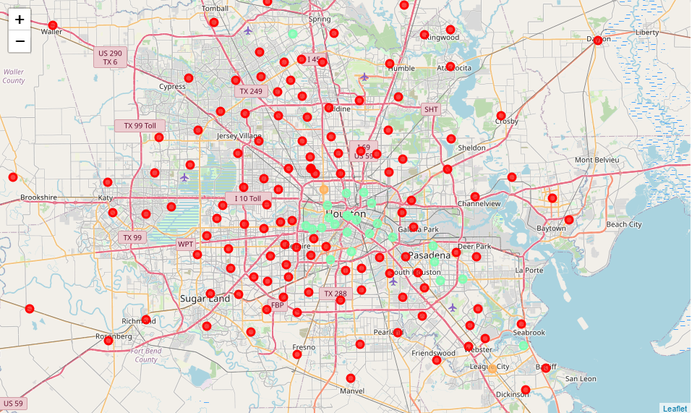
Discussion
Clustering outcomes
Cluster 1 – Red
Cluster 2 – Purple
Cluster 3 – Light Blue
Cluster 4 – Seafoam Green (in table)
Cluster 5 - Orange

Slide 10
Discussion
Clustering outcomes
Cluster 1 – Red
Largest presence of Beer Gardens and Bars per Zip Code
Cluster 2 – Purple
Bar is Dominate
Cluster 3 – Light Blue
Beer Garden and Bars are near equal weight
Cluster 4 – Seafoam Green (in table)
Largest Concentration of Bars and Beer Gardens
Cluster 5 – Orange
Beer Gardens, Bars, and Breweries all equal weight

Slide 11
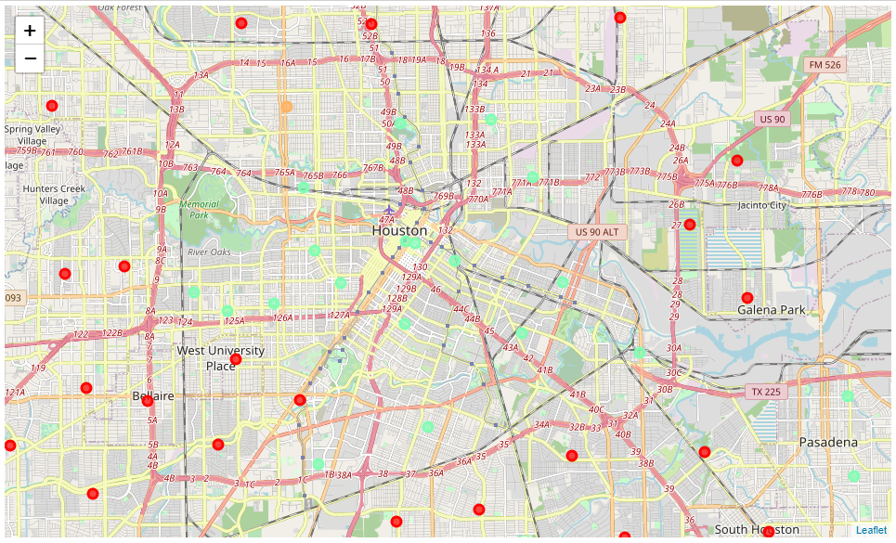
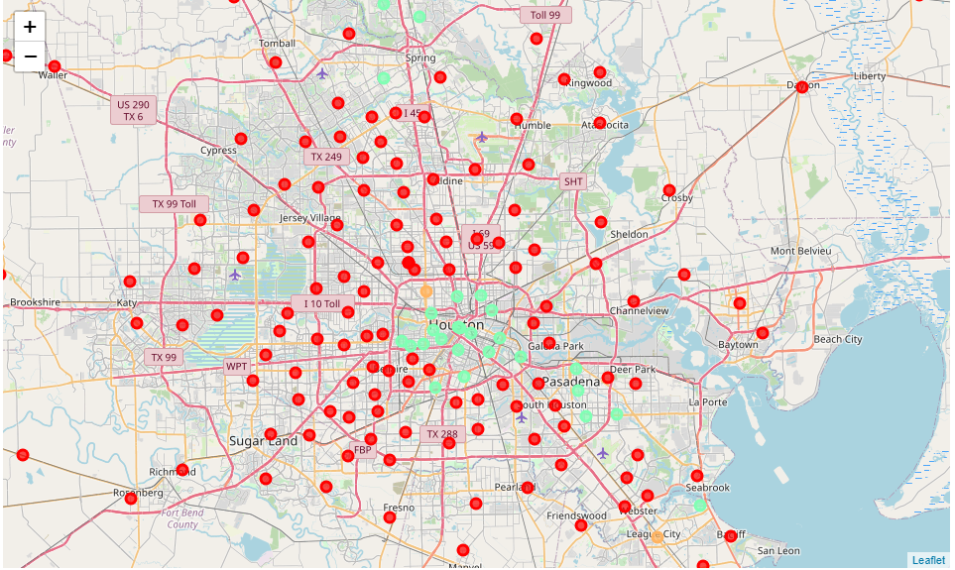
Conclusion
The best placement for a Brewery is AWAY from Cluster 4 (teal)
With the heaviest concentration of Bars and Beer Gardens, it would be ideal to not enter an area with a large concentration of competition
The ideal location would be somewhere in Cluster 1 (red)
Red shows equal distribution of Bars, Breweries, and Beer Gardens
Almost anywhere outside of the 610 loop (highway) would be OK
Minimal competition
Outsude 610 Loop (red)

Slide 12
Conclusion
Our Client has lots of space available within the City of Houston to decide where to start their fledging business of brewing beer, just avoid inside the 610 Loop.

